Slide 1
CS2106 Tutorial 8
Disjoint Memory Allocation

Slide 2
Q1
Walkthrough of Paging / Segmentation / Hybrid schemes

Slide 3
Q1
Each instruction and global variable is a word = 4 bytes.
In this question, we will use words as the unit to measure size
For simplicity, we assume there are only two types of memory usage in a program:
text (instruction) and data (global variables)
Stack & Heap are ignored in this question
inst #1
data #1
inst #2
data #2
inst #3
data #3
inst #4
data #4
inst #5
data #5
inst #6

Slide 4
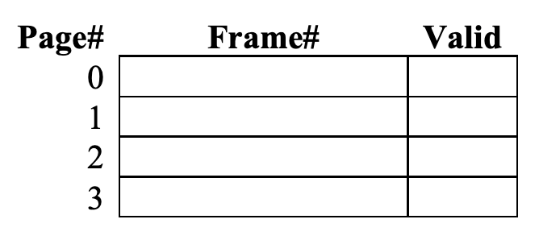
Q1a: pure paging
inst #1
inst #2
Data region placed right after instruction region in logical memory space
In this Qn, valid bit is used to indicate whether the page table entry is correct. Valid bit is 1 if #page maps to #frame correctly and is not some garbage value
inst #3
inst #4
inst #5
inst #6
data #1
data #2
data #3
data #4
data #5

Slide 5

Q1a: pure paging
inst #1
inst #2
Data region placed right after instruction region in logical memory space
Page size = frame size = 4 words
Total physical memory frames = 16
Largest logical memory size = 16 words
a process is able to see and use 16 words for its memory allocation
inst #3
inst #4
inst #5
inst #6
data #1
data #2
data #3
data #4
data #5

Slide 6
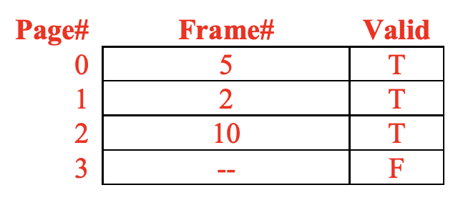
Q1a: pure paging
inst #1
inst #2
Use frames 5, 2, 10, 9 for pages 0, 1, 2, 3 respectively
inst #3
inst #4
inst #5
inst #6
data #1
data #2
data #3
data #4
data #5

Slide 7

Q1a: pure paging
inst #5
inst #1
inst #6
inst #2
data #1
Use frames 5, 2, 10, 9 for pages 0, 1, 2, 3 respectively
inst #3
data #2
inst #4
inst #5
inst #6
inst #1
data #1
inst #2
data #2
inst #3
data #3
inst #4
data #4
data #5
data #3
data #4
data #5

Slide 8
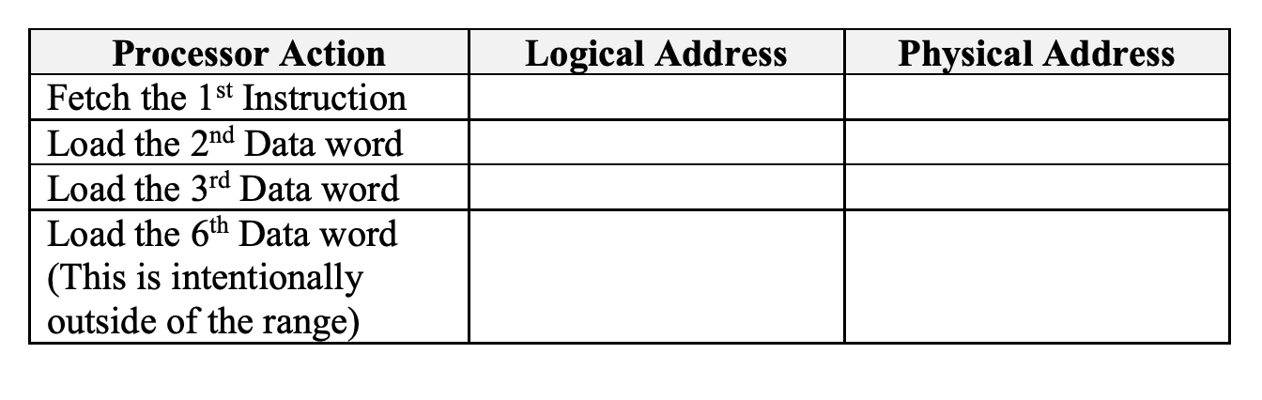
Q1a: pure paging
inst #5
inst #1
inst #6
inst #2
data #1
Find out the logical address and the corresponding physical address for the following actions taken by the processor.
inst #3
data #2
inst #4
inst #5
inst #6
inst #1
data #1
inst #2
data #2
inst #3
data #3
inst #4
data #4
data #5
data #3
data #4
data #5

Slide 9

Q1a: pure paging
inst #5
inst #1
inst #6
inst #2
data #1
Find out the logical address and the corresponding physical address for the following actions taken by the processor.
inst #3
data #2
inst #4
inst #5
inst #6
inst #1
data #1
inst #2
data #2
inst #3
data #3
inst #4
data #4
data #5
data #3
data #4
data #5

Slide 10
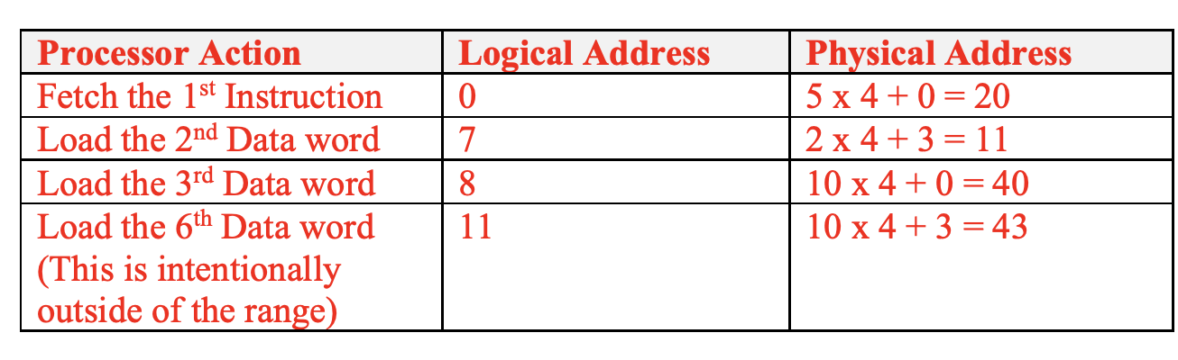
Q1a: pure paging
inst #5
inst #1
inst #6
inst #2
data #1
Note 1:
Observe that the consecutive logical addresses may not be consecutive in physical memory (e.g. 2nd and 3rd Data word).
Note 2:
Incorrect memory access is not catchable if it is still within valid page boundary.
inst #3
data #2
inst #4
inst #5
inst #6
inst #1
data #1
inst #2
data #2
inst #3
data #3
inst #4
data #4
data #5
data #3
data #4
data #5

Slide 11
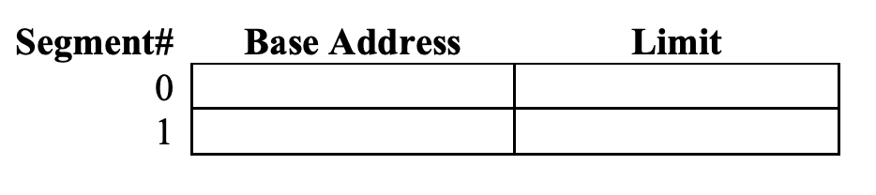
Q1b: pure segmentation
inst #1
data #1
inst #2
data #2
inst #3
data #3
Assuming text and data are stored in segments 0 and 1
Use addresses 50 and 23 as the starting addresses for the two segments, respectively
inst #4
data #4
inst #5
data #5
inst #6

Slide 12
Q1b: pure segmentation
data #1
data #2
data #3
Assuming text and data are stored in segments 0 and 1
Use addresses 50 and 23 as the starting addresses for the two segments, respectively
data #4
data #5
inst #1
inst #2
inst #3
inst #4
inst #5
inst #6

Slide 13
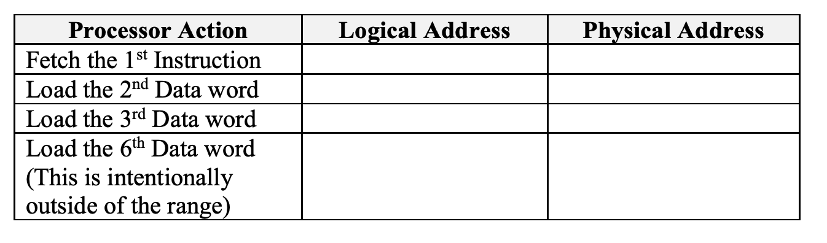
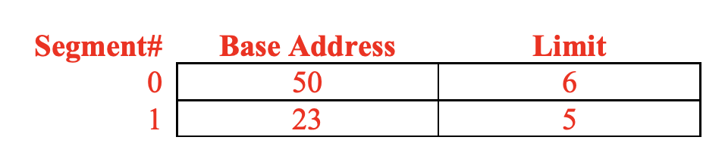
Q1b: pure segmentation
data #1
data #2
data #3
find out the logical address and physical address for the following processor actions:
data #4
data #5
<seg no, offset>
inst #1
inst #2
inst #3
inst #4
inst #5
inst #6

Slide 14
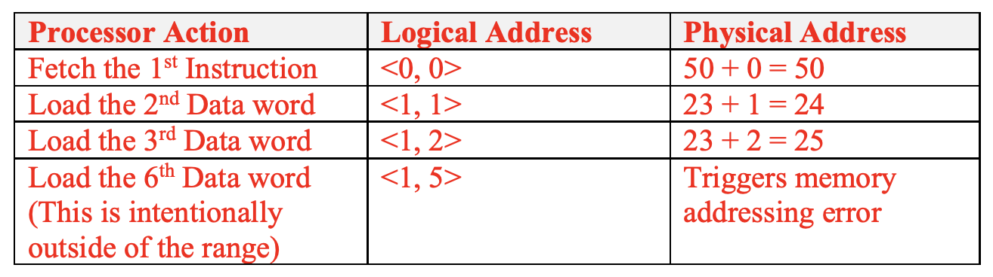
Q1b: pure segmentation
data #1
data #2
data #3
find out the logical address and physical address for the following processor actions:
data #4
data #5
inst #1
inst #2
inst #3
inst #4
inst #5
inst #6

Slide 15
Q1c: Segmentation + Paging
inst #1
data #1
inst #2
data #2
inst #3
data #3
assume the pages from the
code segment are allocated to frames 7, 4, 1, and 2 and
data segment allocated to frames 9, 3, 14, and 6
inst #4
data #4
inst #5
data #5
inst #6
<seg no, page no, offset>

Slide 16
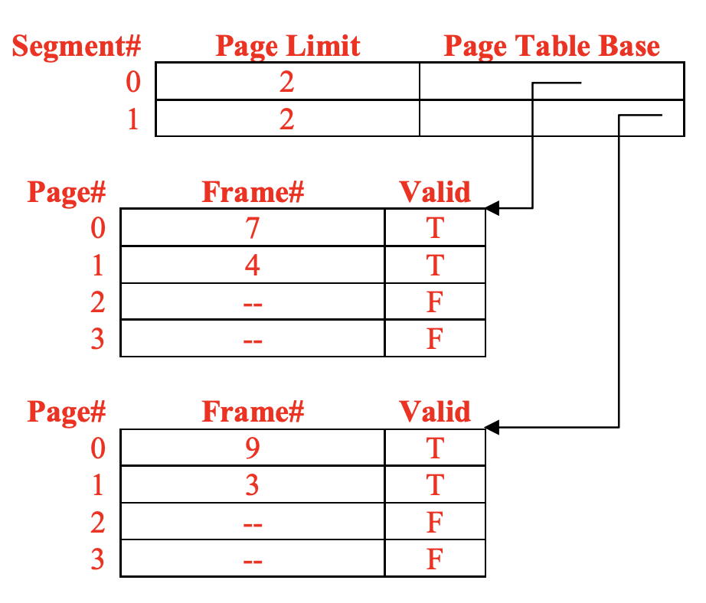
Q1c: Segmentation + Paging
inst #1
data #1
inst #2
data #2
inst #3
data #3
inst #4
data #4
inst #5
data #5
inst #6

Slide 17
data #5
inst #5
inst #6
inst #1
inst #1
data #1
inst #2
inst #2
data #2
inst #3
inst #4
inst #3
data #3
inst #4
data #4
data #1
inst #5
data #5
data #2
inst #6
data #3
data #4

Slide 18
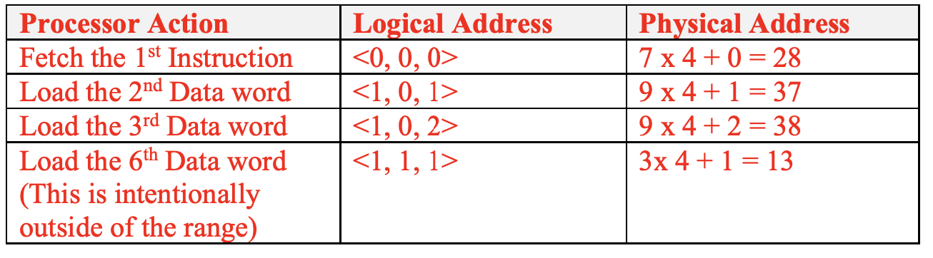
Note: As the limit in segment table now refers to the limit of pages in the corresponding page table, memory error that is in page boundary is now "not catchable".
data #5
inst #5
inst #6
inst #1
inst #1
data #1
inst #2
inst #2
data #2
inst #3
inst #4
inst #3
data #3
inst #4
data #4
data #1
inst #5
data #5
data #2
inst #6
data #3
data #4

Slide 19
Q2
TLB

Slide 20
Q2
Suppose the system uses the paging scheme with the page tables entirely stored in physical memory (DRAM). The page size is 4KB, and the logical addresses are 32-bit long.
Assuming the system does not use TLB and accessing DRAM takes 50ns (nanoseconds), what is the latency of accessing a global variable of type char?

Slide 21
Q2
Suppose the system uses the paging scheme with the page tables entirely stored in physical memory (DRAM). The page size is 4KB, and the logical addresses are 32-bit long.
Assuming the system does not use TLB and accessing DRAM takes 50ns (nanoseconds), what is the latency of accessing a global variable of type char?
first access:
find physical address from logical.
need to access the page table
second access:
access the actual char at the physical address on RAM
50ns + 50ns = 100ns

Slide 22
Q2
Suppose the system uses the paging scheme with the page tables entirely stored in physical memory (DRAM). The page size is 4KB, and the logical addresses are 32-bit long.
Assuming accessing DRAM takes 50ns (nanoseconds), and assuming the system uses a TLB and 75% of all page-table references hit in the TLB. What is the average memory access time? You can assume that looking up a page table entry in TLB takes negligible time.

Slide 23
Q2
TLB Miss:
first access:
find physical address from logical.
need to access the page table
second access:
access the actual char at the physical address on RAM
Suppose the system uses the paging scheme with the page tables entirely stored in physical memory (DRAM). The page size is 4KB, and the logical addresses are 32-bit long.
Assuming accessing DRAM takes 50ns (nanoseconds), and assuming the system uses a TLB and 75% of all page-table references hit in the TLB. What is the average memory access time? You can assume that looking up a page table entry in TLB takes negligible time.
TLB Hit:
first access:
find physical address from logical from the TLB
negligible time
second access:
access the actual char at the physical address on RAM
75% * 50ns + 25% * 100ns = 62.5ns

Slide 24
Q2
Suppose the system uses the paging scheme with the page tables entirely stored in physical memory (DRAM). The page size is 4KB, and the logical addresses are 32-bit long.
How many entries does a TLB need to have to achieve a hit ratio of 75%? Assume the program generates logical memory addresses uniformly at random.
total page table entries
= total number of pages
= total logical mem space / page size
= 2³² / (4 * 2¹⁰)
= 2²⁰
75% * 2²⁰ = 786432 entries

Slide 25
Q2
Using this reasoning, it seems impossible to have a TLB large enough to guarantee a high hit-rate.
You may be surprised that TLB is actually quite small in real-world machines (commonly in the range of 32 to 1024 entries) due to the high hardware complexity (associative search is expensive in term of hardware).
However, TLB hit ratio is still very high in actual usage (commonly with 99% hit rate!). The main contributing reason is that memory access are not uniformly distributed.
This can be understood with the aid of locality principle: it is more likely to have repeated memory accesses to same (temporal locality) or different (spatial locality) parts of the same memory page in a time interval rather than uniformly spread accesses.
Suppose the system uses the paging scheme with the page tables entirely stored in physical memory (DRAM). The page size is 4KB, and the logical addresses are 32-bit long.
How many entries does a TLB need to have to achieve a hit ratio of 75%? Assume the program generates logical memory addresses uniformly at random.

Slide 26
Q3
Segmentation

Slide 27
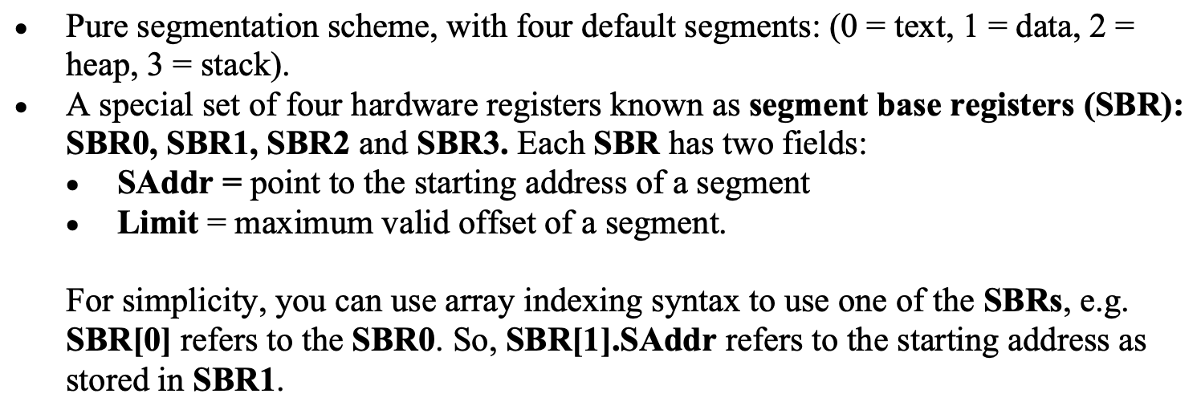
Q3

Slide 28
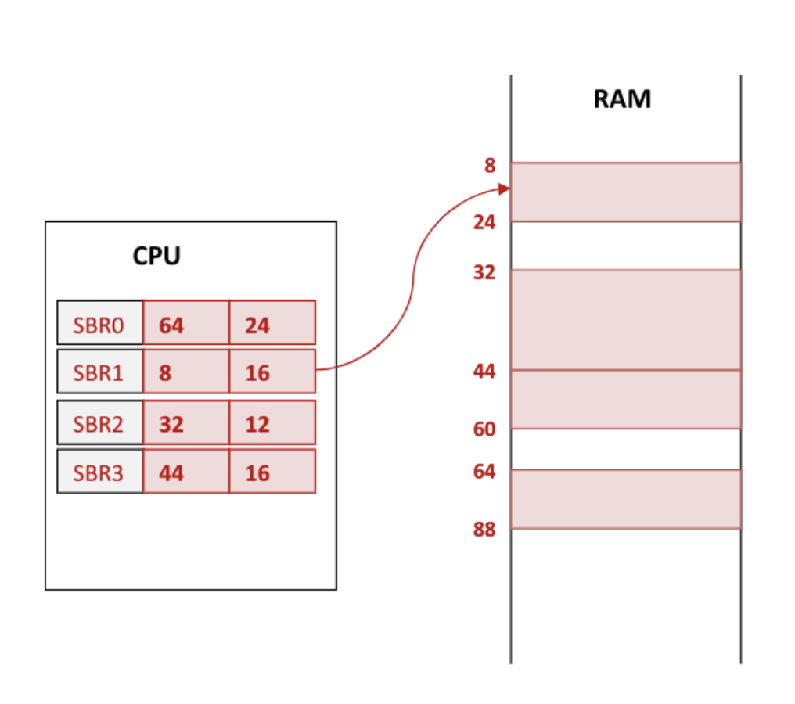
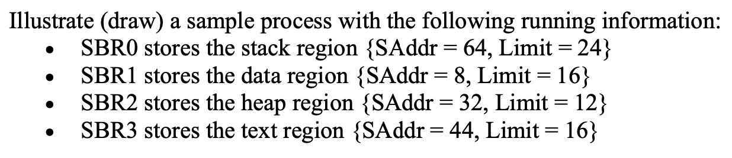
Q3a

Slide 29
Q3b
Briefly describe how to handle malloc() (dynamic memory allocation) for the sample process in (a).

Slide 30
Q3b
Briefly describe how to handle malloc() (dynamic memory allocation) for the sample process in (a).
As the heap region is already bordering on the text region,
We need to find a larger free piece of memory for relocating the heap region.
SBR2 will store new base and limit afterwards

Slide 31
Q3c
Do we need caching mechanism like TLB in this machine? Briefly explain.

Slide 32
Q3c
Do we need caching mechanism like TLB in this machine? Briefly explain.
We do not need TLB in this machine The SBRs are hardware registers, which give very fast access to the physical address lookup already.

Slide 33
Q3d
Briefly explain how thread switching, i.e. switching between two threads in the same process, can be supported on this machine efficiently. Your answer only need to focus on the memory context (i.e. ignore hardware context etc)
What should be saved as part of the thread context?

Slide 34
Q3d
Briefly explain how thread switching, i.e. switching between two threads in the same process, can be supported on this machine efficiently. Your answer only need to focus on the memory context (i.e. ignore hardware context etc)
What should be saved as part of the thread context?
Only stack region needs to be switched. So, the SBR0 should be saved as part of a text context.
Upon switching, we simply swap the SBR0 to the one saved in the thread context.
T1’s SBR0 saved to thread context
-> SBR0 set to value from T2
-> T2 runs

Slide 35
Q4
copy on write

Slide 36
Q4
As discussed in lecture, we can protect a memory page by adding permission bits to the page table entry (PTE). Suppose we add 3 access right bits: {R: Readable, W: Writable, X: Executable} to each PTE. When a processor instruction violates the access permission of a page, OS will be invoked to handle the problem. We can utilize this behavior to implement the copy-on-write mechanism. Also discussed in lecture, copy-on-write can be used to reduce the memory usage during the fork() system call, by allowing memory pages to be shared between parent and child process until modified. In this question, we will explore these ideas using a simplified example.

Slide 37
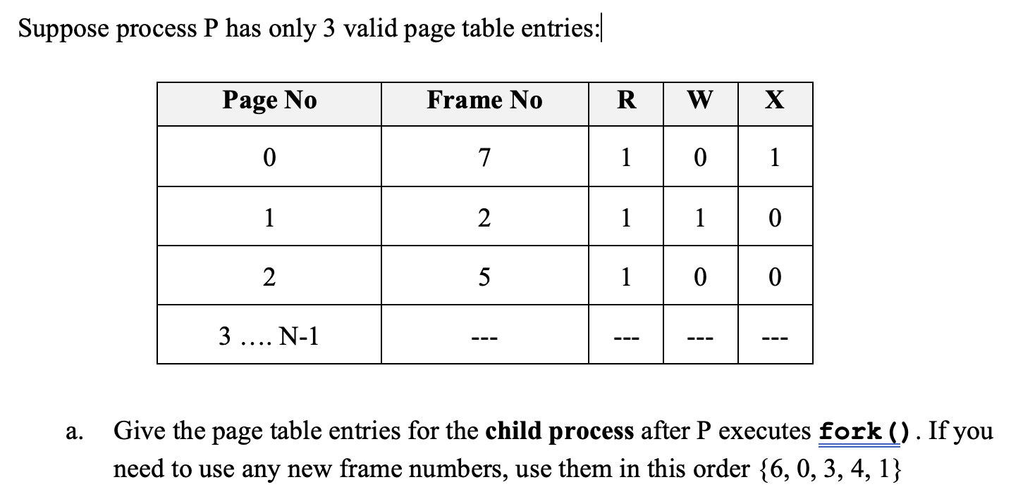
Q4a

Slide 38
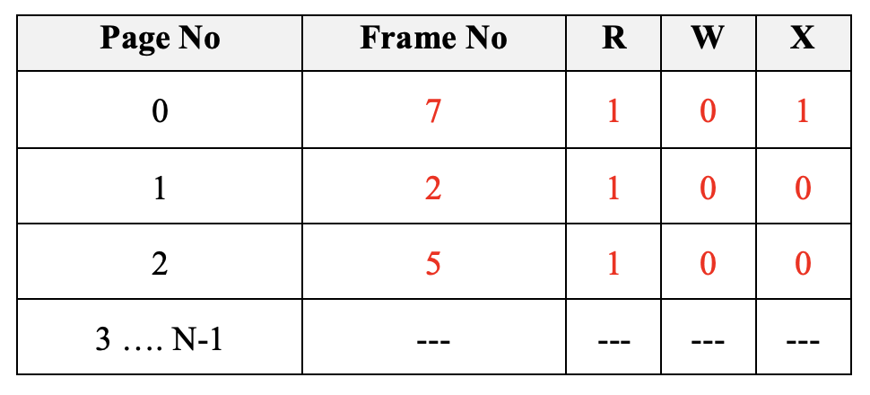
Q4a
Page #0 and #2 are read-only pages, which need not be duplicated, i.e. simply shared between parent and child processes.

Slide 39
Q4b
What are the steps required to handle copy-on-write? Indicate any additional information that OS need to maintain. Show the affected PTE(s) for the child process afterwards.

Slide 40
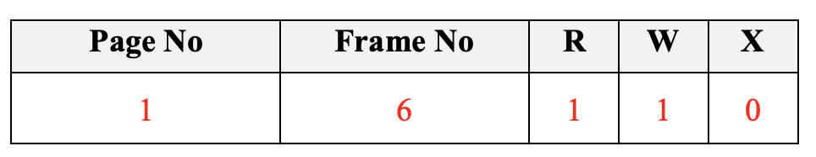
Q4b
What are the steps required to handle copy-on-write? Indicate any additional information that OS need to maintain. Show the affected PTE(s) for the child process afterwards.
Memory store triggers against page with no writable permission.
OS checks that this is a copy-on-write page (additional information).
a. allocate new frame
b. copy current content over to (a)
c. Re-perform the memory store
Where frame #6 contains mostly the original page#1 information and the new memory store value.

Slide 41
Q4b
Linux maintains a separate data structure (called virtual memory area – VMA) in addition to the page table to keep track of memory mappings and what are the access permissions for every memory area and page.
If a particular page is marked as writable in the VMA and the corresponding entry in the page table for that page is marked as non-writable, the OS recognizes that page as a copy-on-write page (COW).
When a process tries to modify such a page, a page fault occurs, and the page fault handler handles the COW and performs the memory store.
both parent and child page will be marked as read-only.

Slide 42
Optional

Slide 43
Q5
It is possible for a program to dynamically allocate (i.e., enlarge the memory usage) during runtime. For example, the system call malloc() in C or new in Java/C++ can enlarge the heap region of process memory. Discuss the OS mechanisms needed to support dynamic allocation in the following schemes:
Contiguous memory allocation (both fixed and dynamic size partitioning)
Pure Paging
Pure Segmentation

Slide 44
Q5a: Contiguous & Fixed size partitioning
It is simpler to have the heap region to be allocated at the end of the logical memory space. Then, we can enlarge the heap region by enlarging the partition allocated to the process.
Under fixed partitioning:
No extra work is needed, as heap region can simply use up the free space (the internal fragmentation) between the partition size and the actual memory size

Slide 45
Q5a: Contiguous & Fixed size partitioning
It is simpler to have the heap region to be allocated at the end of the logical memory space. Then, we can enlarge the heap region by enlarging the partition allocated to the process.
Under dynamic partitioning:
If the adjacent partition is free:
Simple: Simply modify the partition information, i.e. change the length of current partition and shorten the free partition.
If adjacent partitions are occupied:
More troublesome: The current partition cannot be enlarged. Relocation is required. OS need to look for a large enough free partition to fit the enlarged partition. Once located, the current partition is moved over.

Slide 46
Q5b: Pure Paging
Due to internal fragmentation of the paging scheme, it is possible that the allocation can use the remaining free space in the page. Suppose the allocation overshoot the page boundary, then OS needs to look for a free physical frame f. Afterward, update the page table by changing the first invalid page table entry from invalid to valid and fill in frame number f.

Slide 47
Q5c: Pure segmentation
Idea is similar to the dynamic partitioning.
If there is free memory at the end of the heap segment, then OS can simply update the limit of the segment and reduce the size of the affected free partition.
If there is no free memory, then relocation is required. After relocation, both base and limit of the heap segment needs to be updated.

Slide 48
Q6
Calculate the minimum and maximum percentage of memory capacity lost to internal fragmentation in a system that uses the Buddy allocator. Can the Buddy allocator suffer from external fragmentation?

Slide 49
Q6
Calculate the minimum and maximum percentage of memory capacity lost to internal fragmentation in a system that uses the Buddy allocator. Can the Buddy allocator suffer from external fragmentation?
For an allocation request of N bytes: min fragmentation = 0% (exact fit, N=2^k), max fragmentation = ~50% (N=2^(k-1)+1) Note that internal fragmentation >50% is not possible.
If internal fragmentation is >50%, it would have been split into a smaller block
External fragmentation can still happen!

Slide 50
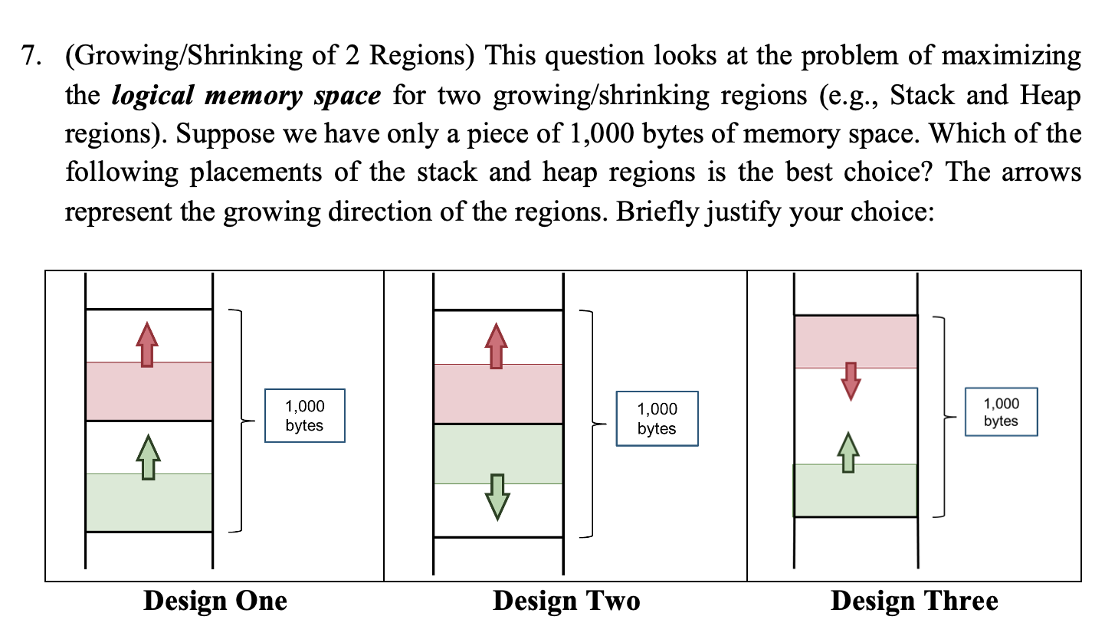
Q7

Slide 51
Q7
Designs #1 and #2 place a pre-defined upper limit on the two regions. These upper limits may not make sense for certain execution behaviour. You can easily find execution scenario that utilize heavily one of the regions over the other (e.g., heavy recursive function calls -> stack region may be exhausted, heavy use of malloc -> heap region may be exhausted instead). In such cases, one of the regions may reached the upper limit even though there may still be free memory space.

Slide 52
Q7
Design three allows free growing of the two regions. The regions reach their maximum size only when the growing boundary of the two regions meet, i.e. the memory space is fully utilized. This is the most commonly seen memory layout (heap and stack grows toward each other).

Slide 53
Thank you!

